Slide 1
HACK o’ HOLICS 3.o
Team OUTLIERS
Problem statement: Gamified Education
Presented by:
Pierrs I K
Adhesh J
Abdur Rahman Ashik
Revan Josh J

Slide 2
Our model and how it encompasses education:
Our model is a simple player vs player game , which pits a user’s(mainly students/chidren) knowledge in a particular topic against another user’s by means of a turn-based question answer point award system . The objective of our game is for one user to gain more points than another user by correctly answering the questions asked ,which enriches their experience. We also aim to provide a extensive report on the performance of each user by using tags for each questions. Hence classifying them on different types ultimately own platform aspires to instigate competition and quick-wittedness in our users.

Slide 3
Our game mechanics:
we are aiming to develop a simple turn based shooter game where if one user answer right ,his/her avatar shoots the other player’s avatar which results in a lose of hitpoints. Each game lasts till one player’s hitpoints reach zero or if the time runs out , whichever comes first. Each questions will a MCQ with 4 options and with a set time to answer, a player forfeits his turn if he/she fails to respond to the question within the allocated time . There are also powerups available for users if they satisfy certain conditions such as answering 3 consecutive question correctly and such

Slide 4
Implementation:
Since our model is not 3-dimensional one nor has high visual requirements , we have opted to use the pygame 2.2.1 module paired with python 3.8.6 . We right now are developing only a game that can run on a pc, but we are working on modifying it so that it can be run on android too, as these are two most used systems for educational purpose.
Why python?
Easy to learn and implement.
Lots of useful functions and in-built libraries to develop necessary like collision handling , players input , graphics and etc.
Most of our focus is on data handling of the questions rather than that by the games so better and easier data analysis can be done in python.

Slide 5
Unique features:
We aim to provide a feature that an enable some user’s to set their own questions onto our game, this feature can be used by educators to set custom questionnaires for their students and by using OOP’s we have encapsulated our questions into a class which will have the option for tagging. This feature will allow us to prepare a much more detailed report than earlier possible.
Example:
question → “ what is the value of 4*3=6/8-4 ”
tags =(“arithmetic”, “logical thinking”)
How exactly? By evaluating the players questions by order of their tags we can find the player’s strong and weak suits and then notify them of said weaknesses and enhance their already strong suits.

Slide 6
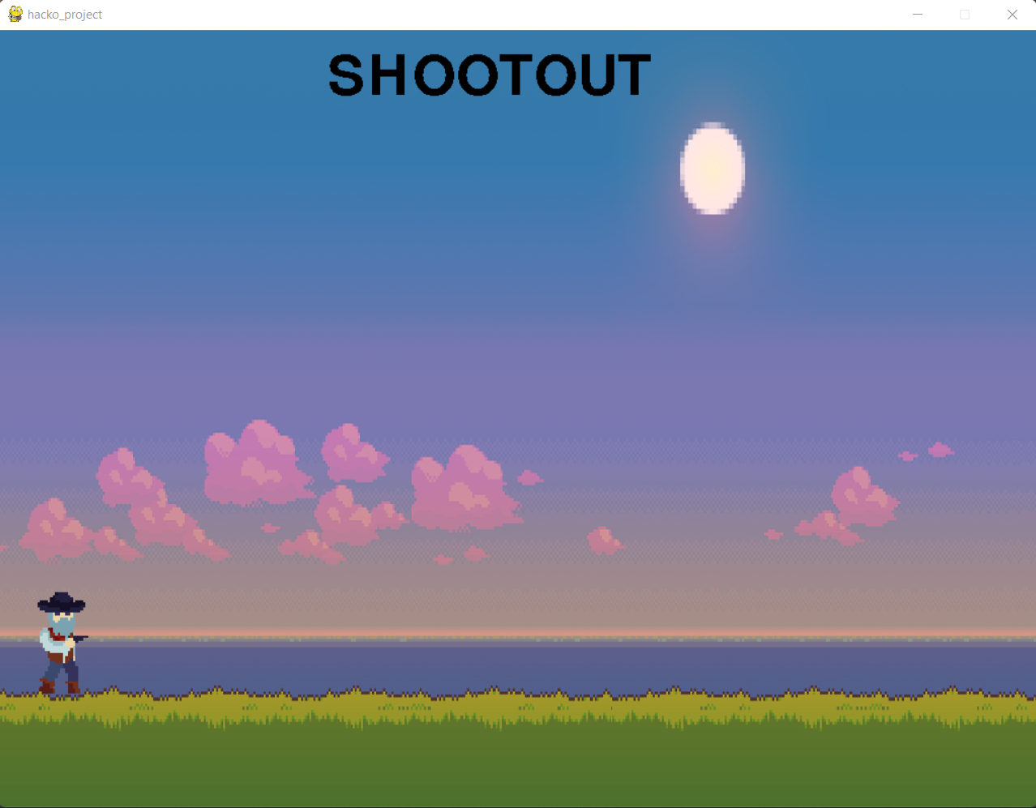
Development:
We have chosen to develop the game in a pixel art style since we are rendering with a main system processor and it also requires no anti-aliasing and finally its is a easy style to create background art, images and simple animation sprite files. We are still in very early stages of development , but , background art an certain sprites are fully developed with some crude animations to go with them. We present them for your perusal below…
THANK YOU !

